Slide 1
19CSE211 Computer Architecture & Organization - MIPS-PIPELINED ARCHITECTURE(PART 2)

Slide 2
Pipeline Hazards
Situations in pipelining when the next instruction cannot execute in the following clock cycle
Three types
Structural hazard
Data hazard (Pipe-line data hazard)
Control hazard (Branch hazard)

Slide 3
Structural Hazards
A planned instruction cannot execute in the proper clock cycle because the hardware can’t support the combination of instructions that are set to execute in the given clock cycle.

Slide 4
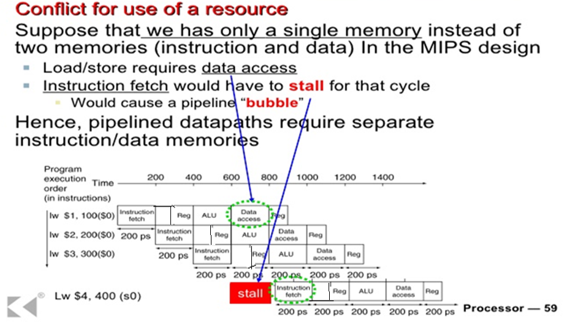
Example for Structural Hazard ……..

Slide 5
Data Hazards
A planned instruction cannot execute in the proper clock cycle because data that is needed to execute the instruction is not yet available
To solve this we use forwarding or bypassing technique
Forwarding - Retrieving the missing data element from internal buffers rather than waiting for it to arrive from programmer-visible registers or memory

Slide 6

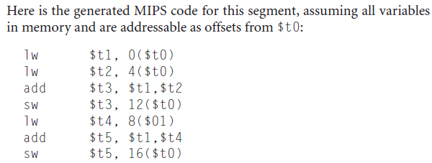
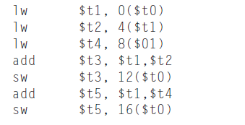
Code Re-ordering Solution
Reordering The Code is Another Solution

Slide 7
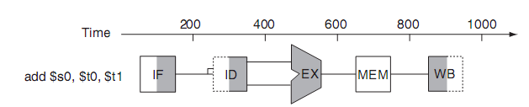
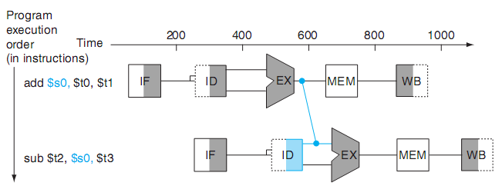
Data Hazards

Slide 8
Control Hazards
A planned instruction cannot execute in the proper clock cycle because the instruction that was fetched is not the one that is needed; i.e., the flow of instruction addresses is not what the pipeline expected.
Arises from the need to make a decision based on the results of one instruction while others are executing.

Slide 9
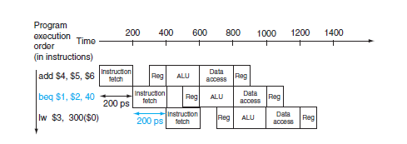
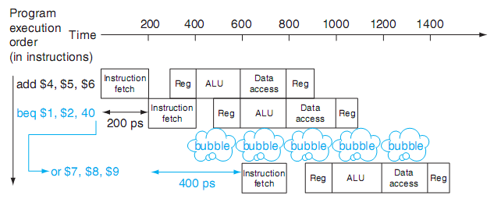
Control Hazards
When the branch is to be taken
When the branch is not taken

